Slide 1

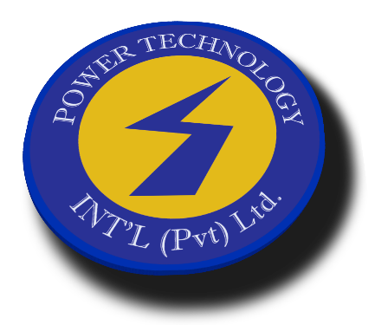
Power Technology International (Pvt) Ltd
Powering Pakistan!
UPS | INVERTERS | BATTERIES | Smart Data Cabinets | STABILIZERS | SOLAR POWER
www.ptiups.com

Slide 2


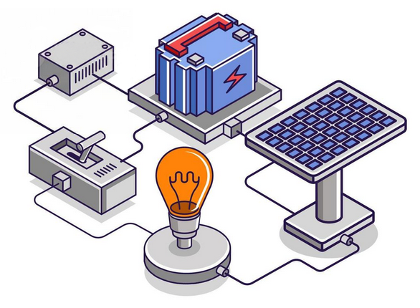
About
Power Technology International is a well- known name in the Information Technology industry for Uninterrupted Power Supply(s), Inverters, Stabilizers, Batteries, Generators, Solar & Wind energy. Since inception, we have maintained continuous and remarkable growth in a tough and competitive market. Consistent growth of a company speaks volumes about the organization, its products, services and the people who work there.
Our dedication to service excellence is more than just a promise; it's a commitment woven into the very fabric of our business. We understand that our products are not just tools but lifelines that keep the operations alive and thriving. That's why our team of experts is committed to providing responsive, personalized support from the moment of first contact and beyond. Whether it’s routine maintenance or emergency support, our service professionals are there to ensure your peace of mind, 24/7.
Innovation is at the heart of what we do. Our research and development team works tirelessly to stay ahead of the curve, ensuring that our products not only meet but exceed the latest standards in technology, efficiency, and sustainability. But we don't stop there; we believe in tailor-made solutions. Understanding that each client has unique needs, we specialize in customizing our offerings to perfectly match your specific requirements.
We're not just another power products company. We are a team of visionaries, innovators, and
problem solvers dedicated to excellence. Our unwavering commitment to quality, customer
satisfaction, and sustainable innovation makes us the preferred choice for those who settle for
nothing but the best.
PTI today employs highly qualified, motivated and experienced staff at over 21 locations all-across
from Karachi to Kashmir. Members of;
Karachi Chamber of Commerce & Industry
Pakistan Engineering Council
Alternate Energy Development Board.

Slide 3
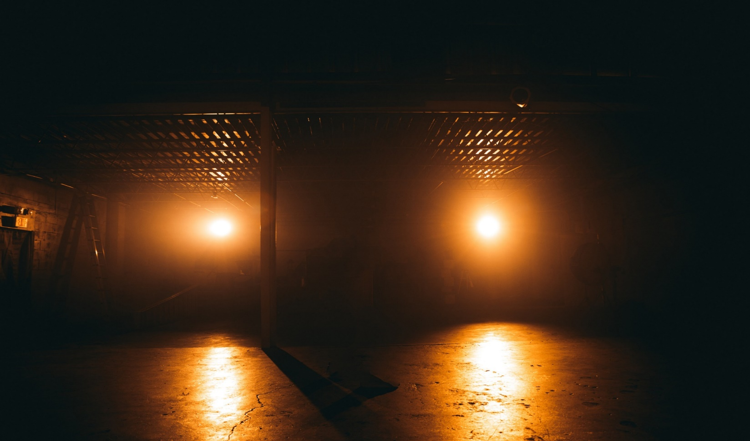
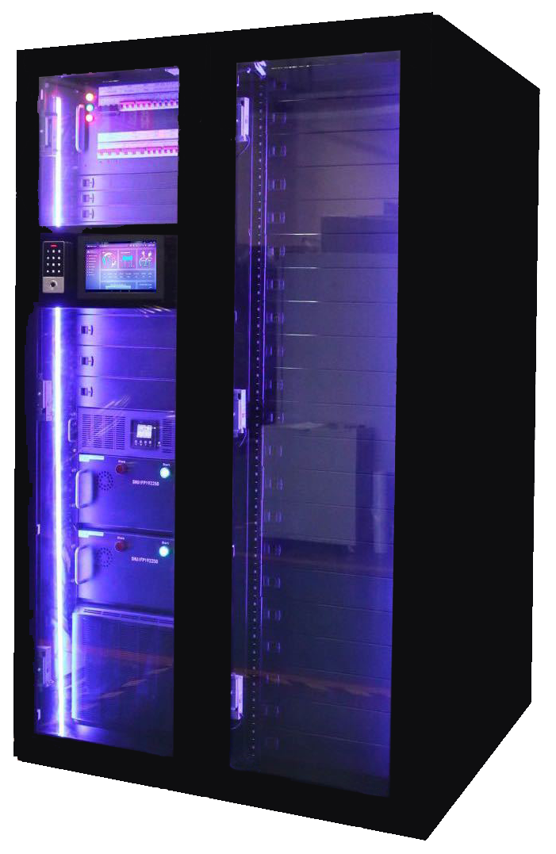
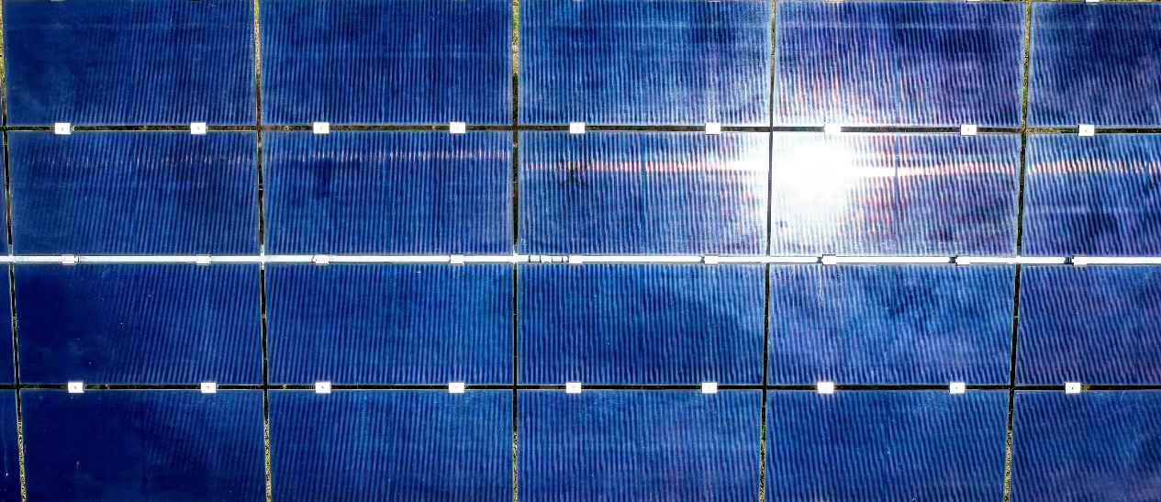

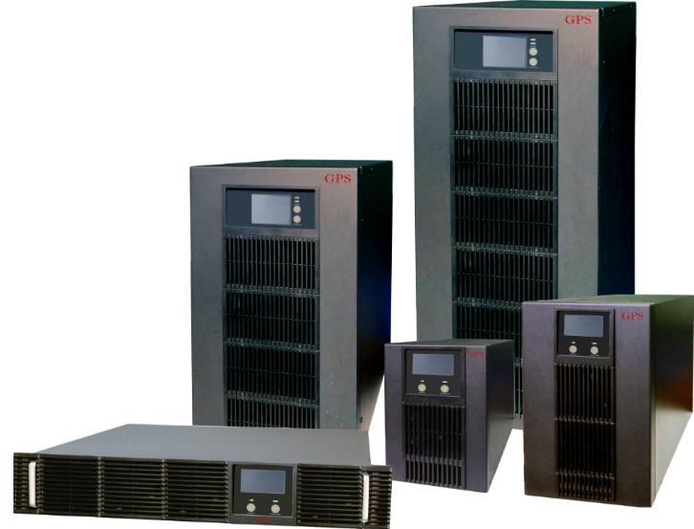

Products
Uninterrupted Power Supply (UPS)
Smart Data Cabinet
Solar & Non-Solar Inverters
Solar Panels & Mounts.
Batteries
Isolation Transformers
Automatic Voltage Regulator (AVR)
Alternate Energy – Solar & Wind power
Generators

Slide 4
















Brands
- Schneider Electric - USA
- General Power Systems – USA
- American Solar - USA
- IREM Stabilizers – Italy
- Powercare – China
- Yuasa Batteries – Japan
- Newmax Batteries – South Korea
- Sacred Sun Batteries - China
- Vision Batteries – Vietnam

Slide 5
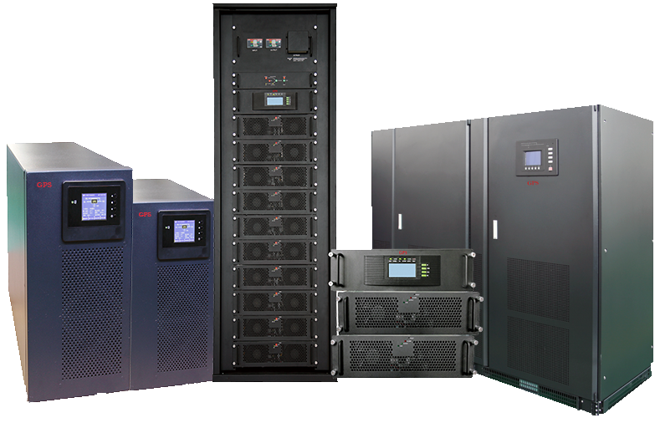

UPS
- Standard & Long Back-up.
From 600 VA – 1000 kVA
- General Power Systems - USA
- Schneider Electric – USA
- Powercare - China

Slide 6
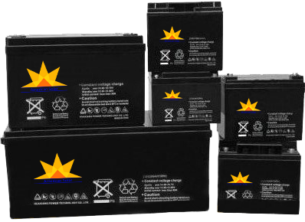
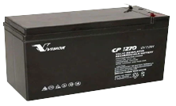
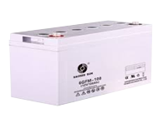

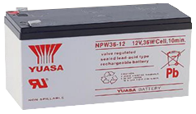
Batteries
Lithium-ion, SLA, GEL, Deep Cycle.
From 12v5A – 12v250A
- American Solar - USA
- Yuasa Batteries – Japan
- Newmax Batteries - Korea
- Sacred Sun Batteries - China
- Vision Batteries – Vietnam

Slide 7
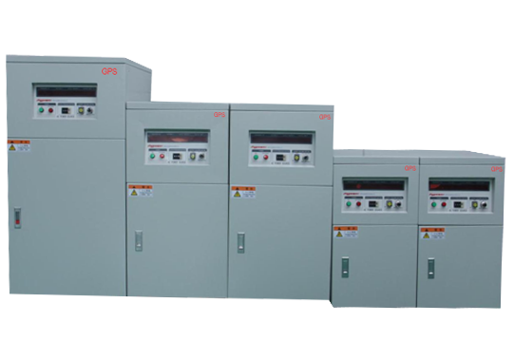
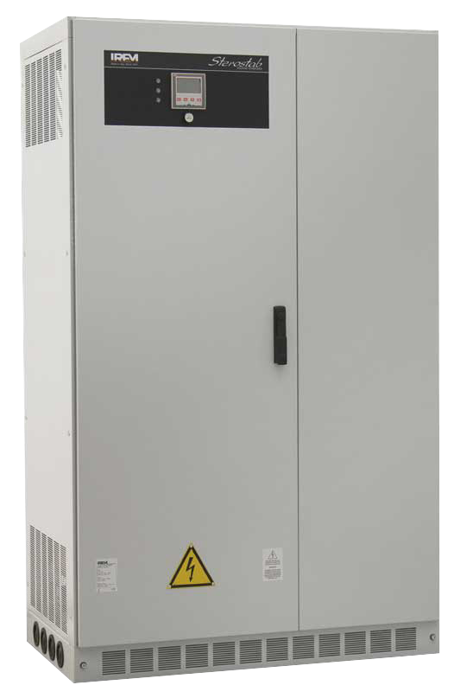
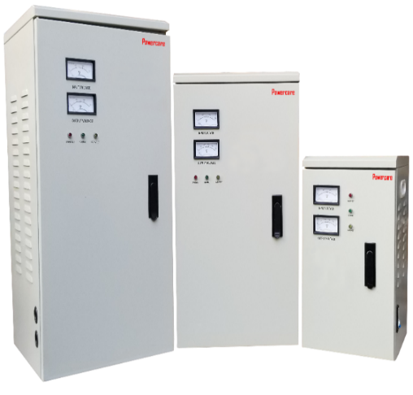
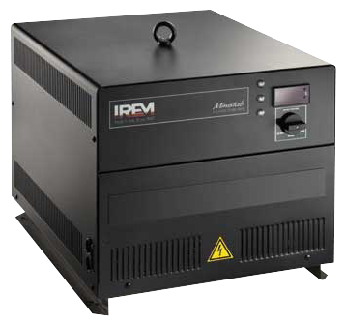
Automatic Voltage Regulator
Servo Motor & Electronic Type.
From 5 kVA – 2000 kVA
- Irem - Italy
- General Power Systems - USA
- Powercare – China

Slide 8
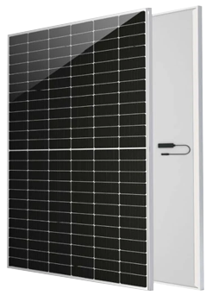
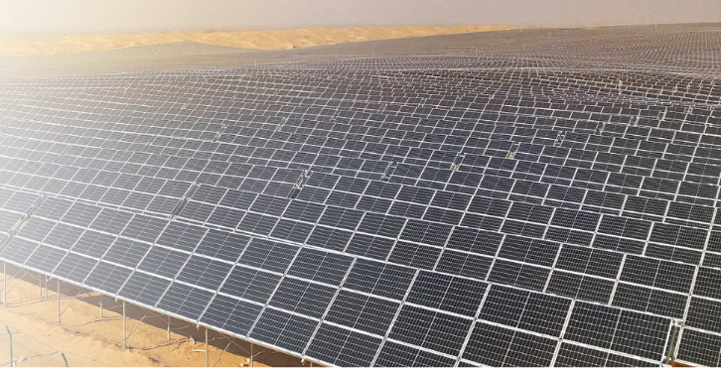
Solar Energy
Polycrystalline | Monocrystalline,
Half Cut & Bi Facial.
- Longi - China
- JA Solar - China
- Trina – China
- Yingli – China
- Canadian Solar
Maximum Power Output
530 – 555 W
Maximum Efficiency
21.48%
Positive Power Tolerance
0 ~ +5W

Slide 9

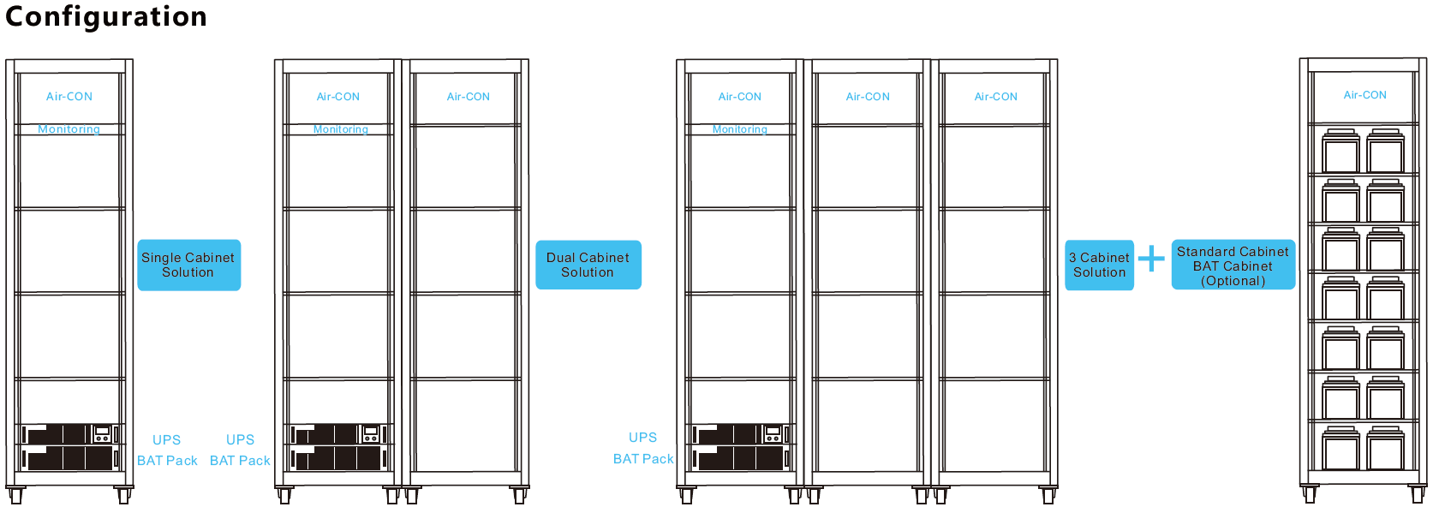
Data Cabinet
All-in-one solution for server-rooms to save space and efficient device protection.

Slide 10

Scope of Services
Largest service network in our industry
24 Hours support and service.
Superior after sales and customer services.
State of the art laboratory for testing & repairing.
Consultation.
Procurement.
Installation.
Annual Maintenance Contracts.
Tailor Made Solutions.
Minimized equipment failure.
Improved reliability.
Reduced operational cost.

Slide 11
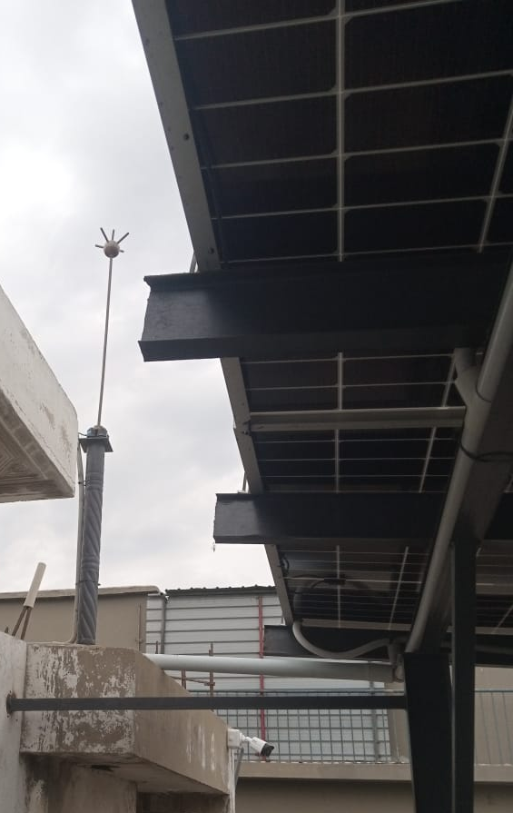
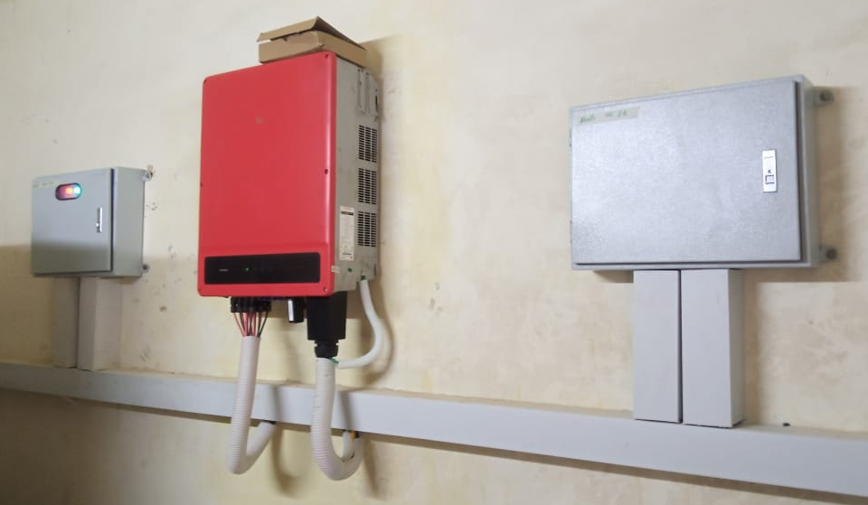
Past Performance
HBL Site – 60 kW
Solar Setup with wiring & mounting.

Slide 12
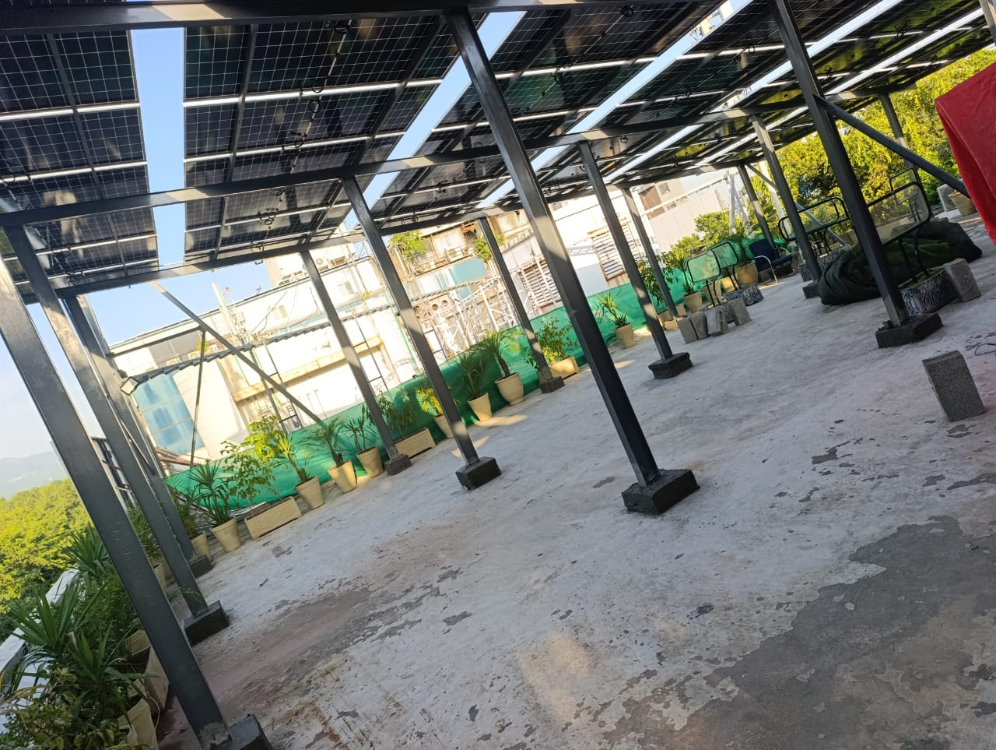
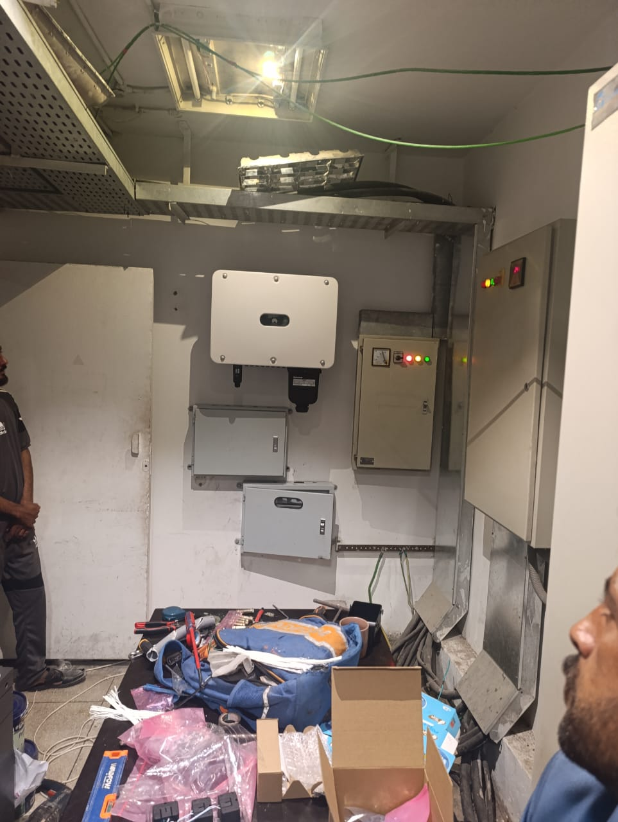
Past Performance
HBL F7 Islamabad – 50 kW
Solar Setup with wiring & mounting.

Slide 13
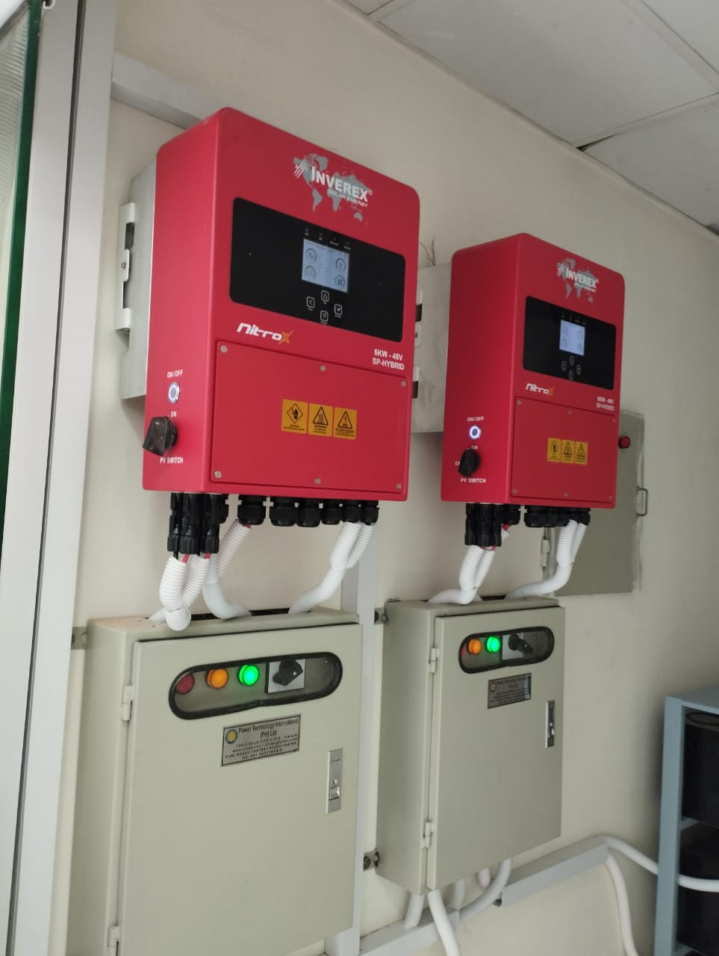
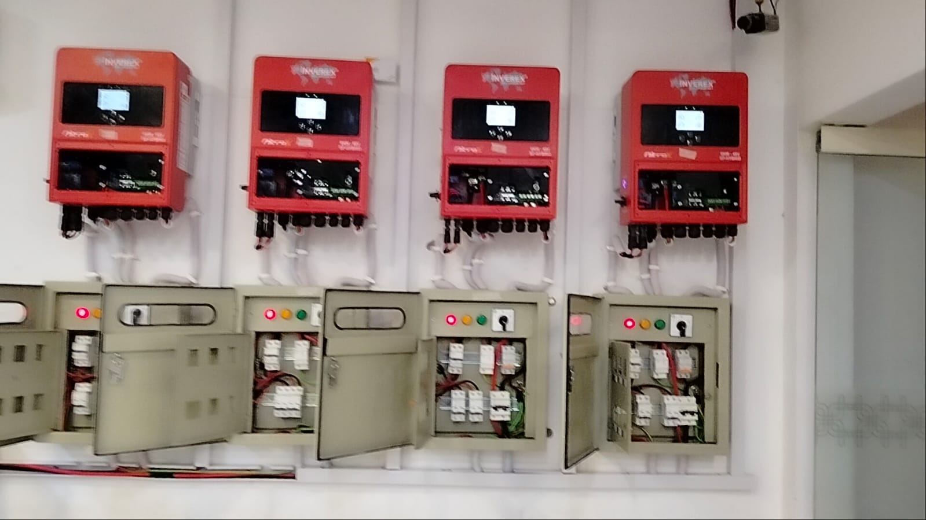
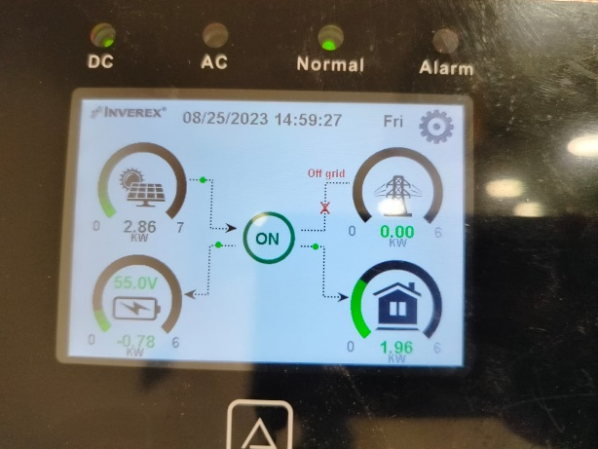
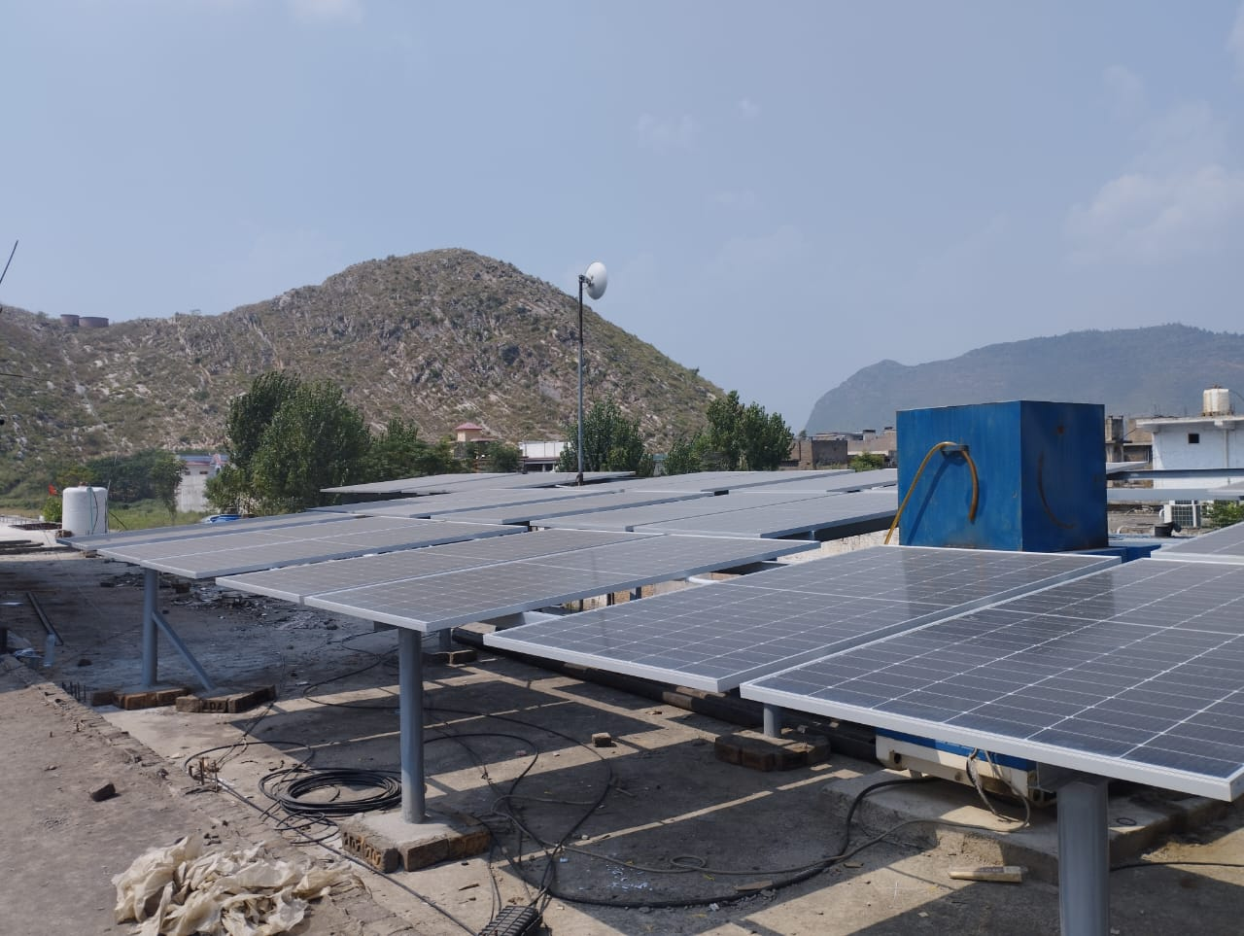
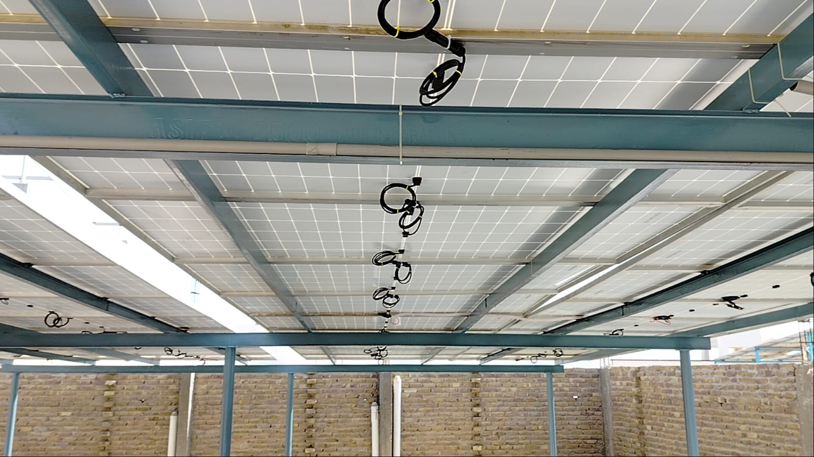
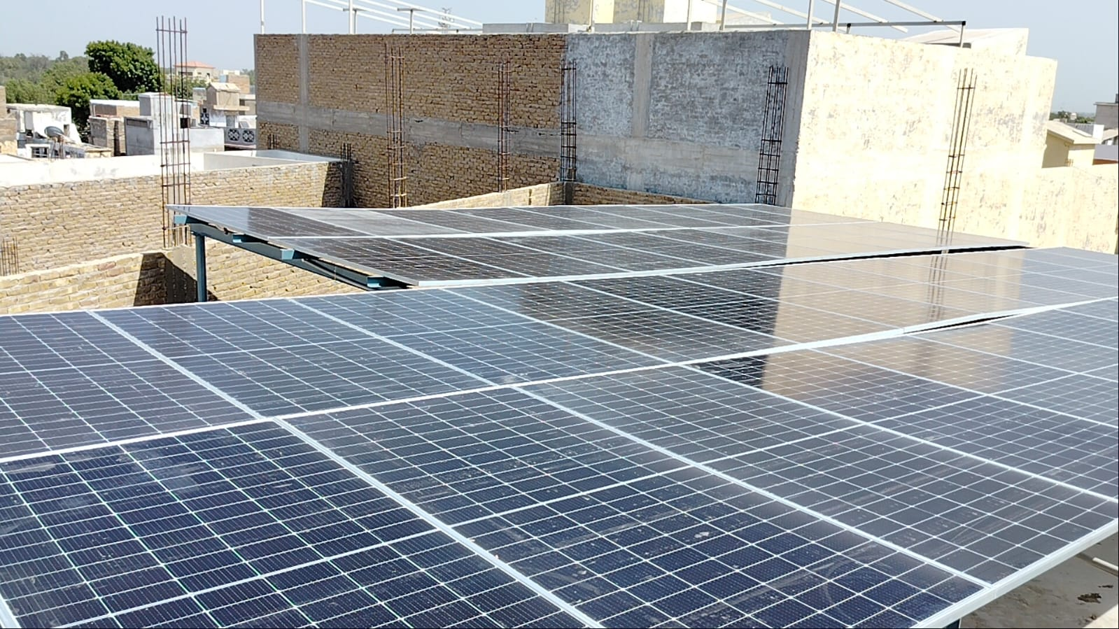
Past Performance
Various Branches across Pakistan.
Solar Setup with wiring & mounting.

Slide 14
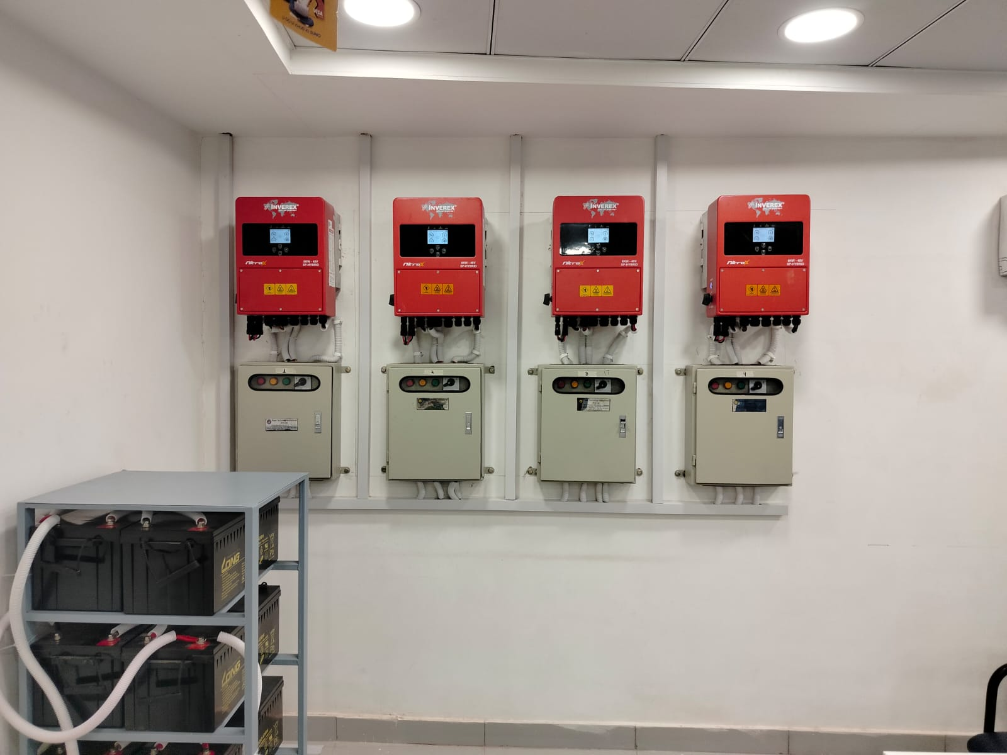
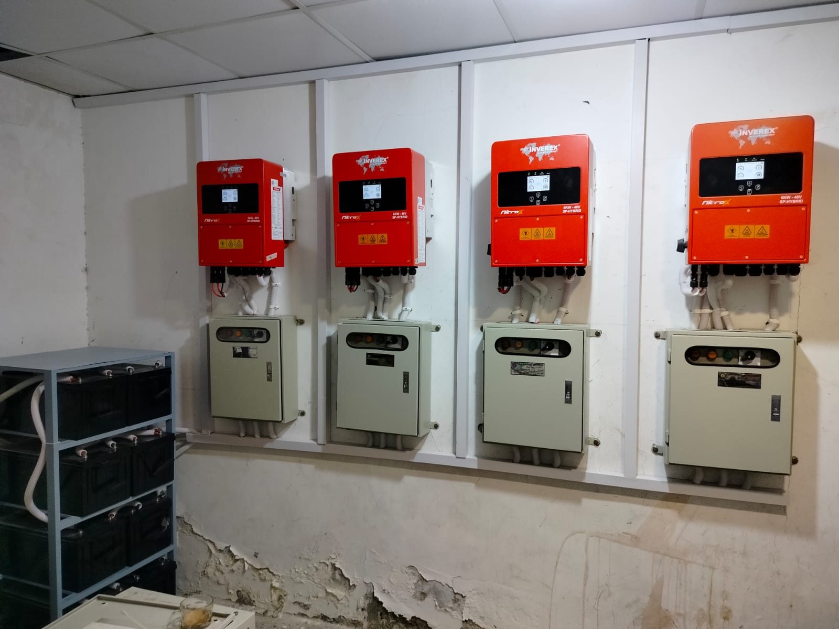
Past Performance
Various Branches across Pakistan.
Solar Setup with wiring & mounting.

Slide 15
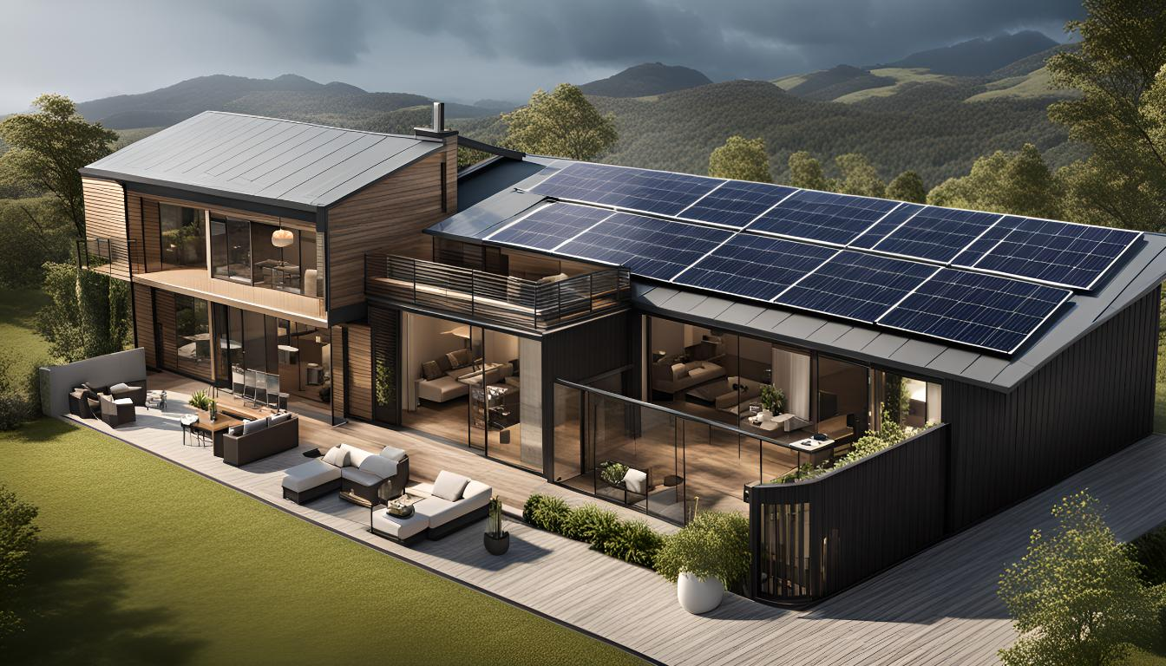
Sustainability
We are committed to powering a cleaner, more resilient future through sustainable energy solutions. Specializing in solar power systems, battery storage, UPS, and voltage stabilizers, we help homes and businesses reduce their reliance on conventional energy sources while improving efficiency and reliability.
Our solar solutions harness renewable energy to lower carbon footprints, while our advanced batteries ensure uninterrupted power without dependence on fuel-based backups. Our UPS systems and stabilizers further optimize energy usage by protecting equipment, reducing wastage, and enhancing overall system performance.
Sustainability drives every aspect of our approach—from energy-efficient technologies and responsible sourcing to durable, long-lasting designs. By delivering smart, scalable solutions, we enable our customers to achieve energy independence while contributing to a greener, more sustainable future.

Slide 16
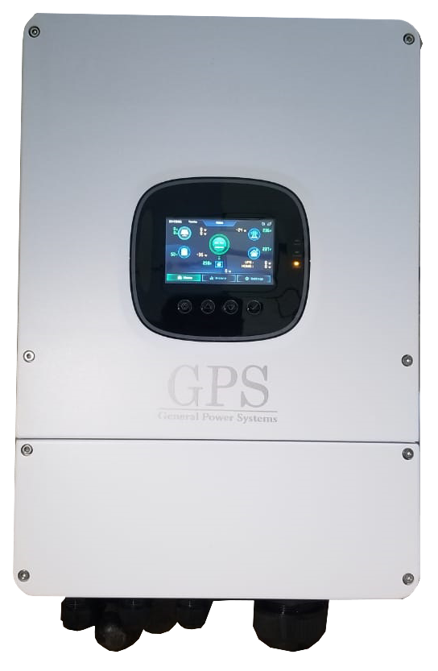
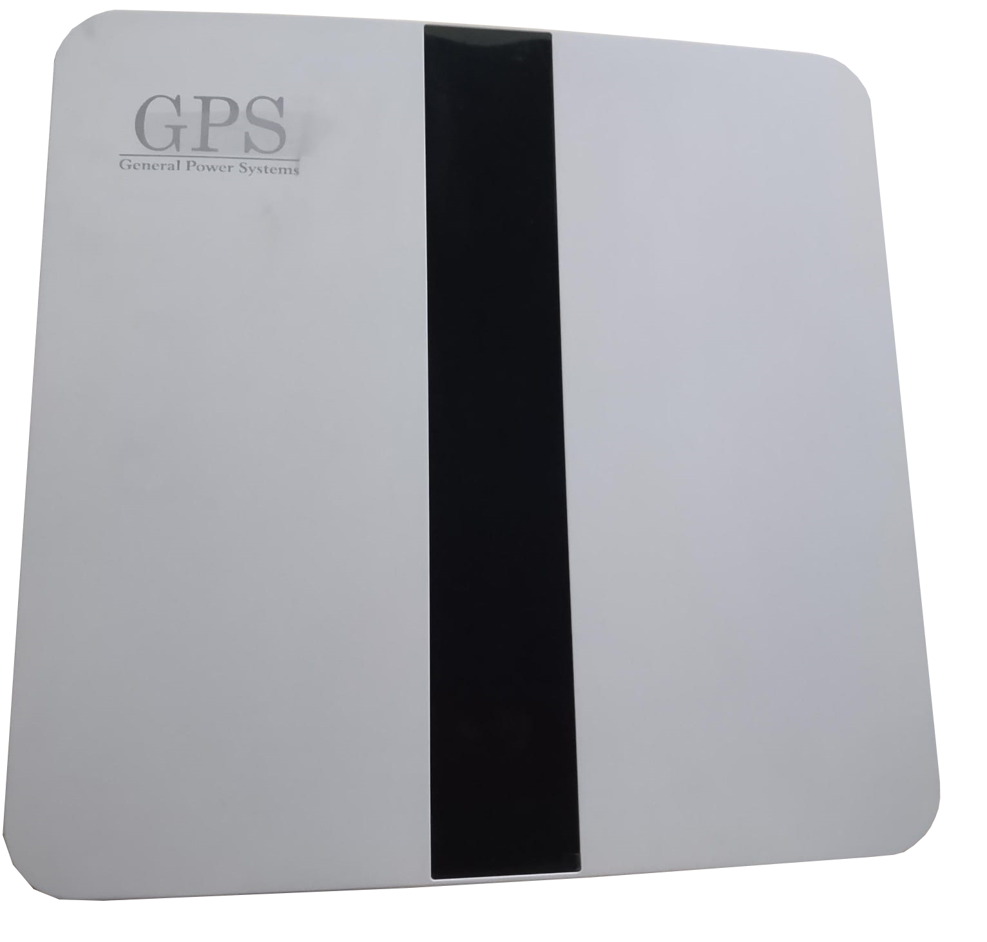
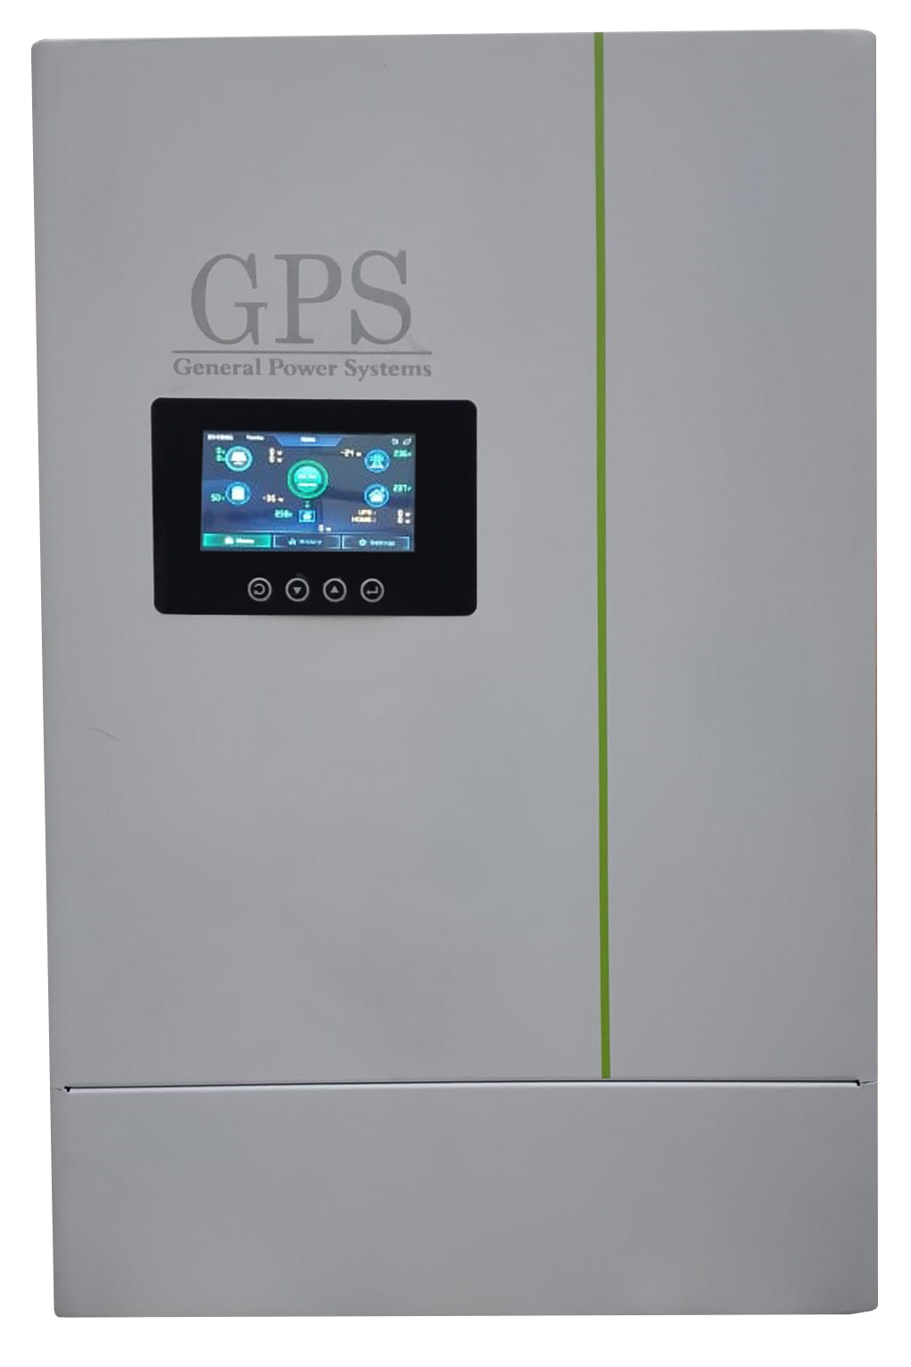
Solar Inverters

Slide 17
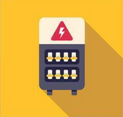

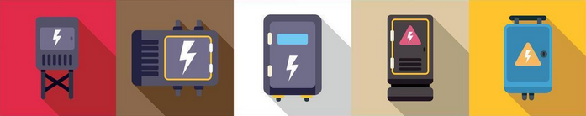
Our Network
At PTI, we are constantly in search of acquiring the finest expertise thus offering the best available products, superior after sales service and better value for money. Our products are not only backed by warranty, but are also fully supported by an efficient and prompt after sales service team with abundant inventory of genuine spares at their disposal. We stand by our work 100%
Industry Experience of over 25 years.
Serving over 1200 towns & cities.
21 service stations nationwide.
33+ satisfied corporate customers.
Over 30 MW in installations.

Slide 18
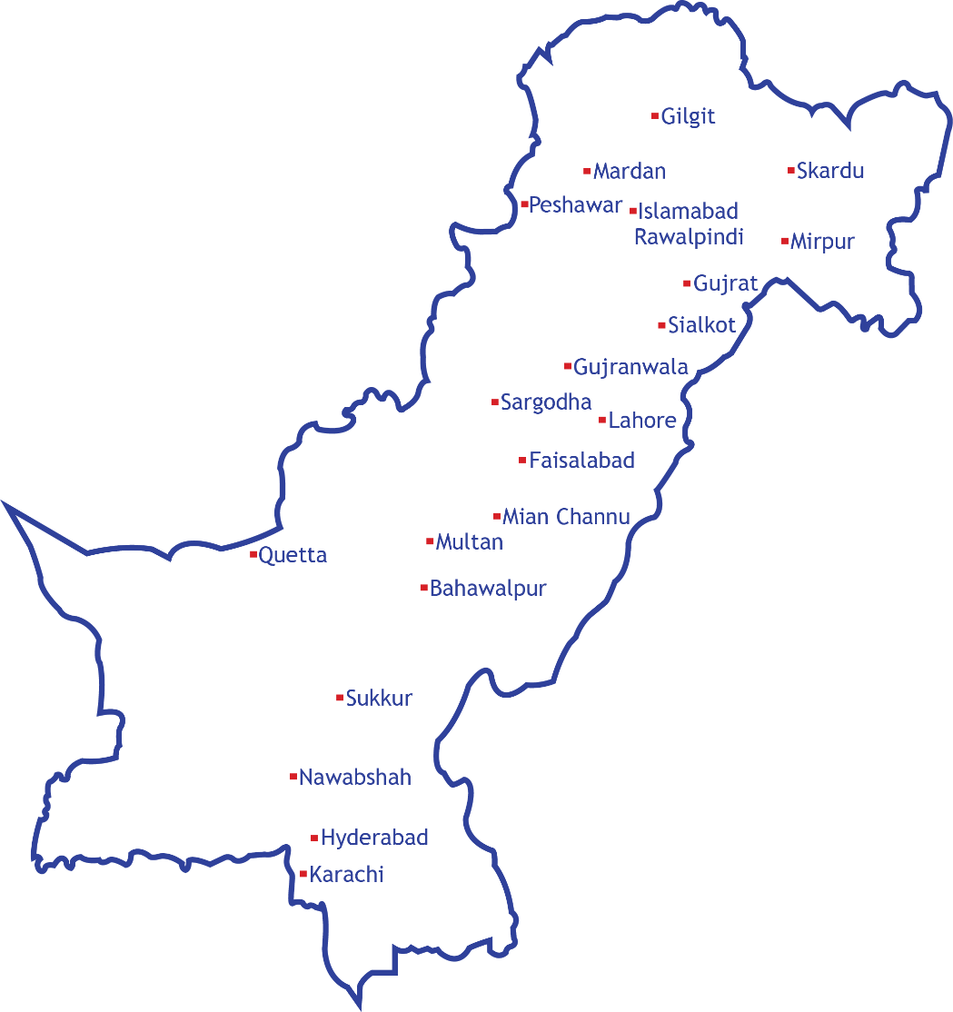
Nationwide Coverage
After-Sales Service
We can provide complete after sales services throughout Pakistan, and Afghanistan.
Currently providing after sales services for:
General Power Systems
Powercare
Artronic
Socomec
APC
MGE
Powerware
Liebert
Emerson
Riello
Sales Consultation | Preventive Maintenance | Remote Monitoring | Rental Options | Buy-Backs
Specialized solutions for 24/7 on up-time, every time, and all the time.

Slide 19
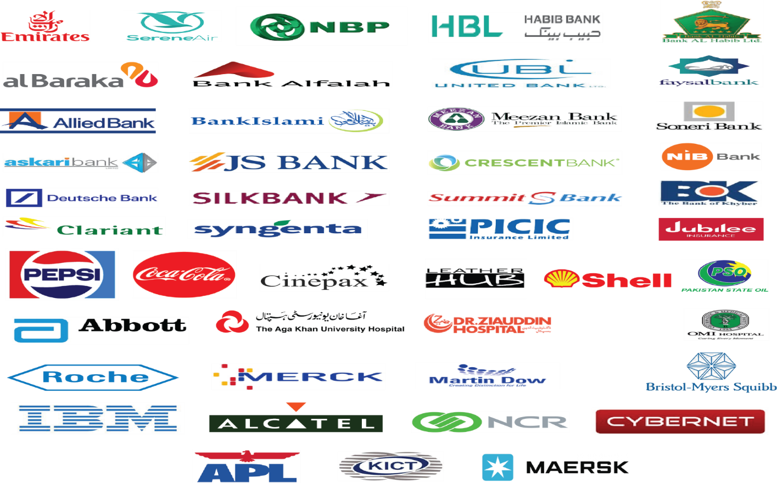
Our Clients

Slide 20
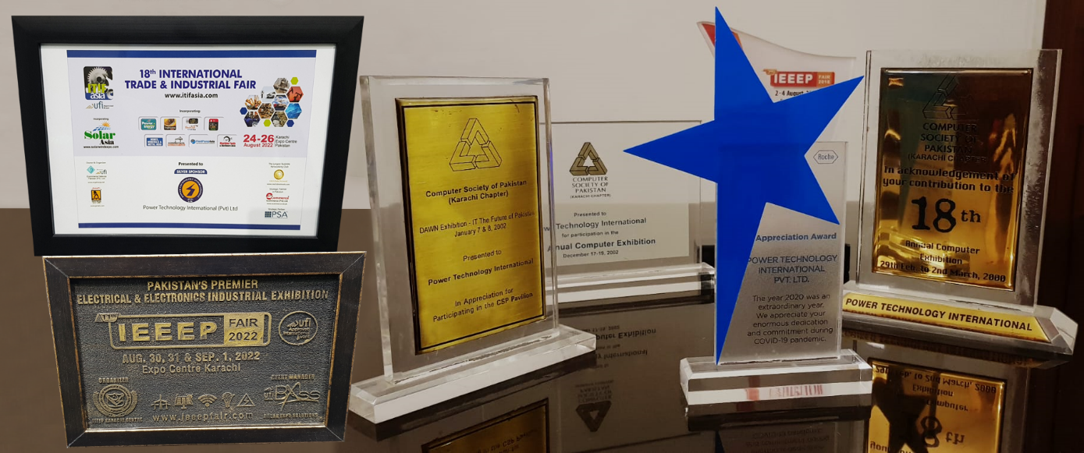
Industry Recognized
Our greatest asset and hope for the future is the reputation that we have reaped, combined with our dedicated work force, led by a team of experienced engineers, marketing personnel, support and customer services staff.
We are your power partners, our commitment is to provide reliable answers to your queries every step of the way;
Consultation, Procurement, Installation, and Quality after sales service.
We value our customers.

